Slide 1
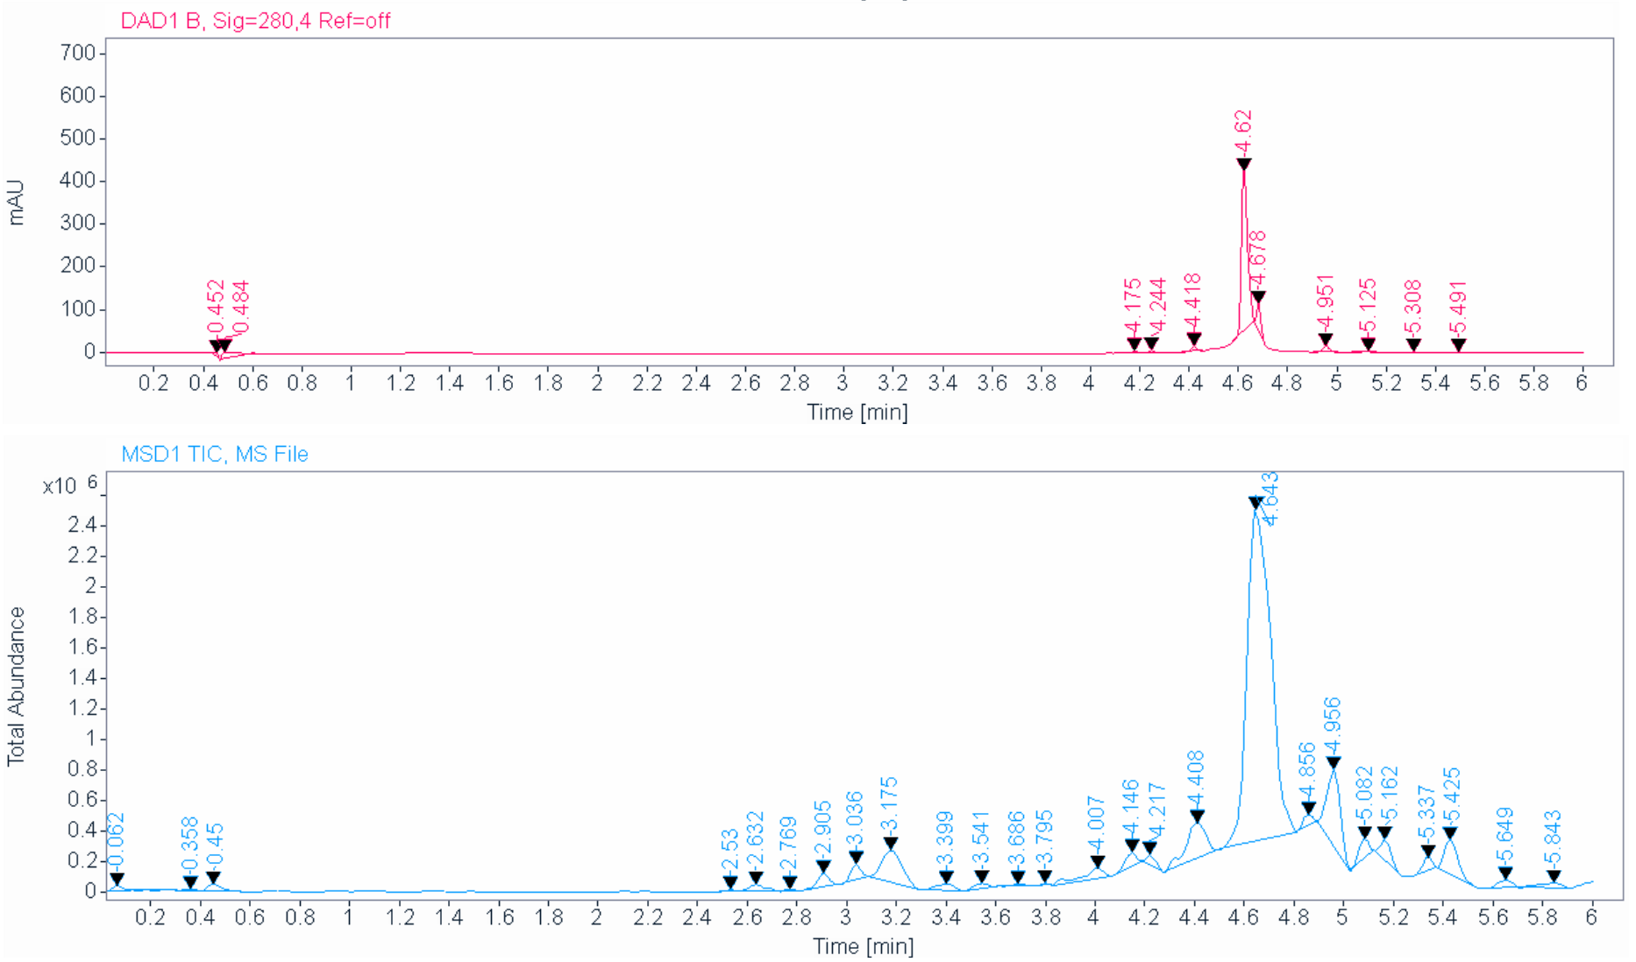
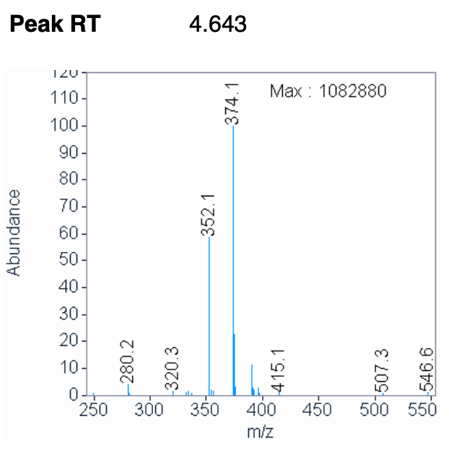
1b – First attempt at ester hydrolysis (LCMS)
Positive mode MS
Alvaro Magalhaes

Slide 2
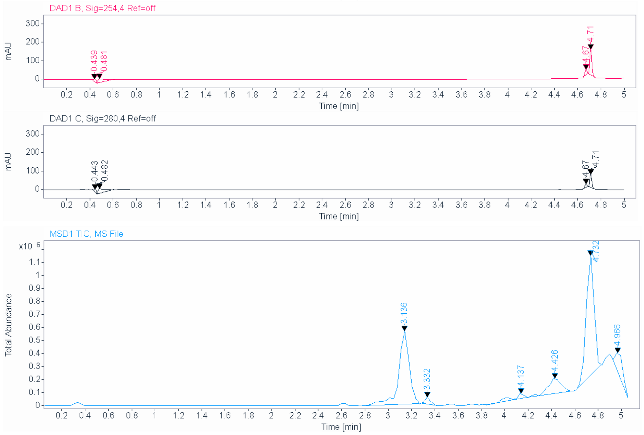
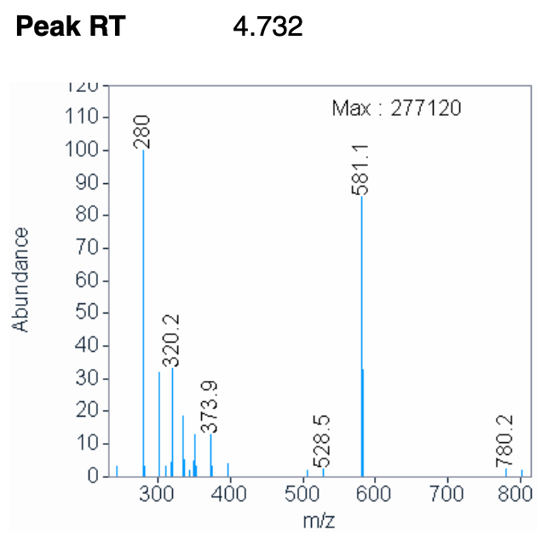
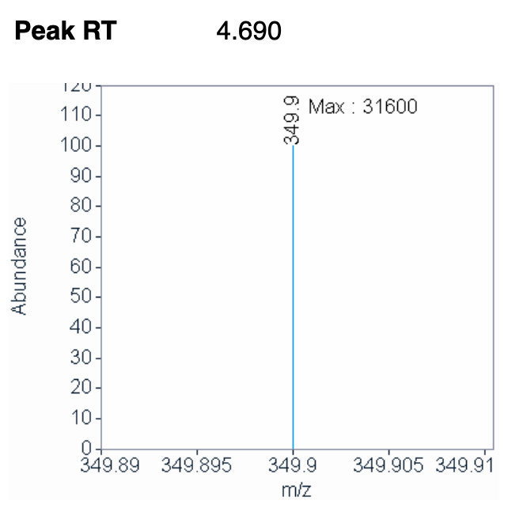
1b – Second attempt at ester hydrolysis (LCMS)
Positive mode MS
Negative mode MS
Alvaro Magalhaes

Slide 3
1b – Second attempt at ester hydrolysis (NMR)
Alvaro Magalhaes

